Slide 1
Economic & Regulatory Capital, Provisioning and Stress testing Basel: Pillars II and III

Slide 2
This Week
Stress Testing
Supervisory Review and Evaluation Process
Pillar II
Pillar III Reports

Slide 3
Stress Test
A bank stress test is an analysis conducted under both baseline and unfavourable economic scenarios which is designed to determine whether a bank has enough capital to withstand the impact of adverse developments.
Stress tests can either be carried out
internally by banks as part of their own risk management, or
by supervisory authorities as part of their regulatory oversight of the banking sector.
These tests are meant to detect weak spots in the banking system at an early stage, so that preventive action can be taken by the banks and regulators.

Slide 4
Steps to carry out a stress test
Determine appropriate scenarios
Calculate shocks to risk drivers in each scenario
Translate changes in risk drivers to portfolio impacts
Produce a forward looking P&L and associated metrics for the timeframe of the scenario
Objectives
Address tail risk
Stress tests can reveal vulnerabilities in specific positions or portfolios
Stress should be extreme but not implausible (1 in 100 often)

Slide 5
Benefits of Stress Testing
Identifies risk concentrations across various business lines
Enables you to better prepare for contingencies
Shapes the risk profile of your bank through better understanding of risk
Promotes discussion about risk that leads to enhanced communication
Can and should help your bank identify additional business opportunities
Provides a platform to better understand the risks associated with existing and new products
Determines if your bank is operating within its risk appetite.

Slide 6
2016 EU Wide EBA Stress Test
2016 EU-wide banking stress test exercise was carried out at the highest level of consolidation on a sample of banks covering broadly 70% of the banking sector
53 EU banks participated in the exercise including AIB and BOI
No single capital threshold was defined for this exercise and banks were assessed against relevant supervisory capital ratios under a static balance sheet
Results informed the 2016 round of Supervisory Review and Evaluation Processes (SREP) under which decisions are made on appropriate capital resources and forward looking capital plans are challenged.
Link is below for completeness.
https://www.eba.europa.eu/-/eba-announces-details-of-2016-eu-wide-stress-test

Slide 7
2016 Key Features
Similar to the 2014 exercise, the 2016 EU-wide stress test primarily focused on the assessment of the impact of risk drivers on the solvency of banks.
Banks were required to stress test a common set of risks (credit risk including securitisations, market risk and counterparty credit risk, operational risk including conduct risk).
In addition, banks were requested to project the effect of the scenarios on net interest income and to stress P&L and capital items not covered by other risk types.
The 2016 exercise added an explicit treatment of conduct risk and FX lending to its scope.

Slide 8
2016 Static Balance Sheet
The EU‐wide stress test was conducted on the assumption of a static balance sheet.
Assets and liabilities that matured within the time horizon of the exercise were to be replaced with similar financial instruments in terms of type, credit quality at date of maturity and original maturity as at the start of the exercise.
No workout or cure of defaulted assets was assumed in the exercise. In particular, no capital measures taken after the reference date 31 December2015 are to be assumed.
It was assumed that banks maintain the same business mix and model (geographical, product strategies and operations) throughout the time horizon.
With respect to the P&L, revenue and costs, assumptions made by banks were to be in line with the constraints of zero growth and a stable business mix.
There were no exemptions from the static balance sheet assumption.

Slide 9
EBA Stress Test 2016
The high level narrative of the adverse scenario reflected the four systemic risks identified by the European Systemic Risk Board as representing the most material threats to the stability of the EU financial sector:
An abrupt reversal of compressed global risk premia, amplified by low secondary market liquidity;
Weak profitability prospects for banks and insurers in a low nominal growth environment, amid incomplete balance sheet adjustments;
Rising of debt sustainability concerns in the public and non-financial private sectors, amid low nominal growth;
Prospective stress in a rapidly growing shadow banking sector, amplified by spillover and liquidity risk.
This high level scenario was then converted into specific country level baseline and adverse levels of interest rates, GDP, GNP, unemployment, house prices, stock market performance, exchange rates and other macroeconomic factors.

Slide 10
EBA Stress Test 2016
Let’s review the inputs at a country level.
Document is 2016 EU-wide stress test scenario
And here’s how they did:
Document is 2016 EU-wide stress test results
Examine Table 3, Page 35

Slide 11
Banco Monte dei Paschi: Irish Times 04/07/17
The European Commission gave its blessing to a state bailout of Italy’s Banca Monte dei Paschi di Siena. EU state aid regulators said Rome could inject €5.4 billion after Monte dei Paschi agreed to a drastic overhaul, including the transfer of bad loans to a special vehicle and a salary cap.
The world’s oldest bank and Italy’s fourth biggest lender has been embroiled in a prolonged state rescue after failing to raise €5 billion on the market to shore up its capital. The commission, which last month gave its preliminary approval to the bank’s state bailout, said the five-year restructuring would ensure the bank’s long-term viability.
As part of the overhaul, Monte Paschi will transfer €26.1 billion to a privately funded special vehicle on market terms, with the operation partially funded by Italian bank rescue fund Atlante II. It will also change its business model to focus on retail customers, and small- and medium-sized companies.
This capital injection could only be approved after junior bondholders and shareholders have contributed (€4.3bn) to the costs of restructuring, in line with “burden-sharing” requirements under EU state aid rules,” said EU competition commissioner Margrethe Vestager.

Slide 12
EBA Stress Test 2020
The narrative depicts an adverse scenario related to a prolonged period of historically low interest rates coupled with a strong drop in confidence leading to a significant weakening of economic growth in EU countries. This is amplified by trade tensions at the global level. Slowing growth momentum and/or rising risk premia could further challenge debt sustainability in the public and private sectors across the EU.
The possible prolongation of negative growth and the low interest rate environment could further exacerbate the search for yield behaviour by investors, leading to under-pricing of risks and asset price misalignments, which could reverse as market sentiment changes and risks materialise.
The adverse scenario ensures an adequate level of severity. By 2022:
EU real GDP would decline by 4.3% cumulatively
Unemployment rate would rise by 3.5 percentage points
Equity prices in global financial markets would fall by 25% in advanced economies and by 40% in emerging economies
residential real estate prices would decline by 16%
commercial real estate prices would decline by 20%.

Slide 13
EBA Stress Test 2021
Let’s examine the narrative and see how thought processes have evolved:
Ongoing concerns about the possible evolution of the COVID-19 pandemic and its economic ramifications trigger adverse confidence effects worldwide and prolong the economic contraction
Reassessment of expectations amid declining corporate earnings leads to an abrupt and sizeable adjustment of financial asset valuations
Corporate sector indebtedness, already at a high level, paired with the sharp decline in profits, exerts pressure on corporate balance sheets
Over the scenario horizon, GDP contracts by 3.6% in the EU and euro area
As a consequence of material business downsizing and a large number of corporate defaults, unemployment rises sharply across all EU economies
Let’s examine the scenario:

Slide 14
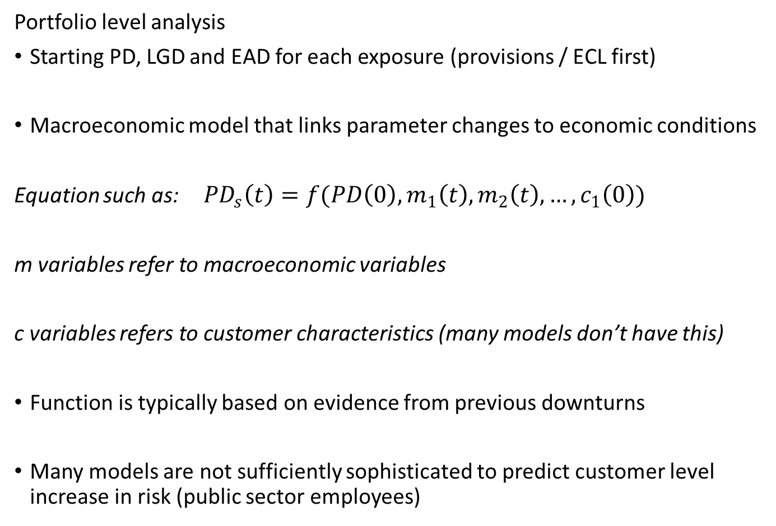
Credit Components of Stress Test

Slide 15
Credit Components of Stress Test (Cont’d)
Calculation Engine – One Possible Design
Gives new PD, LGD and EAD values
Allocates exposures to Stage 2 based on PD increase
Allocates exposures to Stage 3 based very high PD or maybe a randomisation algorithm attached to portfolio prediction (predicted defaulted rate)
Similar exercise for capital parameters
New capital for performing and defaulted exposures
New business performance for dynamic balance sheet stress tests – what grade is new business written at and how much?

Slide 16
Reverse Stress Test
Reverse stress testing is conducted as a complementary stress test along with other general stress tests. The key difference is that with a reverse stress test, the financial institution identifies the kind of scenarios that threaten the sheer survival of the firm. These are the scenarios under which the business model becomes unviable and the firm fails.
The key objective of the reverse stress testing is to overcome disaster myopia and the possibility that a false sense of security might arise from regular stress testing in which institutions identify manageable impacts.
Reverse stress testing is done by starting with a business failure outcome, and then analysing different scenarios that might lead to such a failure. It is naturally a combination of quantitative modelling and qualitative judgment.
A firm’s business model is described as being unviable at the point when crystallising risks cause the market to lose confidence in the firm. A consequence of this would be that counterparties and other stakeholders would be unwilling to transact with or provide capital to the firm and, where relevant, that existing counterparties may seek to terminate their contracts. Thus, a bank might become unviable well before regulatory capital is exhausted.

Slide 17
Global Warming and Stress Testing - BoE
The Bank will use its 2021 biennial exploratory scenario (BES) to explore the financial risks posed by climate change. The exercise will test the resilience of the current business models of the largest banks, insurers and the financial system to climate related risks and therefore the scale of adjustment that will need to be undertaken in coming decades for the system to remain resilient.
Conducting a climate stress test poses distinct challenges compared to conventional macro-financial or insurance stress tests. To ensure it is effective in light of these challenges, the Bank is using this discussion paper to consult relevant stakeholders on the design of the exercise. This includes financial firms, climate scientists, economists, other industry experts, and informed stakeholder groups.
The discussion paper sets out the Bank’s proposal for the 2021 BES as follows:
Chapter 2 outlines the key features, including: participation; the nature of the scenarios; modelling horizon, treatment of balance sheets, and reporting frequency.
Chapter 3 describes the scenario narratives.
Chapter 4 details the scenario specification.
Chapter 5 sets out the modelling approaches.
Chapter 6 sets out the approach to participants’ submissions. This includes the reporting of risk exposures, as well as the management actions participants may take within the scenario.

Slide 18
Four Principles Underlying Pillar II
1. ICAAP (Internal Capital Adequacy Assessment Process)
Banks should have a process for assessing their overall capital adequacy in relation to their risk profile and a strategy for maintaining their capital levels
2. SREP (Supervisory Review & Evaluation Process)
Supervisors should review and evaluate banks’ internal capital adequacy assessments and strategies as well as their ability to monitor and ensure their compliance with regulatory capital ratios. Supervisors should take supervisory action if they are not satisfied with the result
3. Capital Buffers
Supervisors should expect banks to operate above regulatory capital ratios and should have the ability to require banks to hold capital in excess of the minimum
4. Supervisory Intervention
Supervisors should seek to intervene at an early stage to prevent capital from falling below the minimum levels required to support the risk characteristics of a particular bank and should require rapid remedial action if capital is not maintained or restored

Slide 19
Pillar II Comprehensive Risk Assessment
The second pillar – supervisory review – allows supervisors evaluate a bank’s assessment of its own risks and determine whether that assessment seems reasonable. It is not enough for a bank or its supervisors to rely on the calculation of minimum capital under the first pillar. Supervisors should provide an extra set of eyes to verify that the bank understands its risk profile and is sufficiently capitalized against its risks.
Thus, Pillar II is also intended to incorporate risks not specifically captured under the Pillar I process. This includes liquidity risk, interest rate risk, pension risk, credit concentration risk not specifically identified in Pillar I, operational risks not identified in Pillar I, and other idiosyncratic risks. Furthermore, it is intended that Pillar II will capture the interactions between various risks rather than considering each on a stand-alone basis.
Let’s review the original consultative document.

Slide 20
What Risks are Quantified in Pillar II?
Credit risk
Market risk
Operational risk
Liquidity risk
Interest rate risk
Political risk
Insurance risk
Concentration risk
Legal risk
Securitisation risk
Business risk
Reputation risk
Pension risk
Model Risk

Slide 21
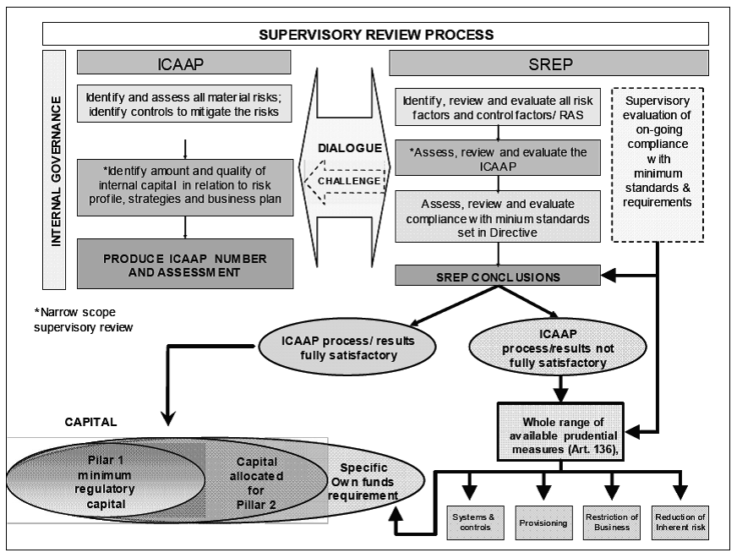
Supervisory Review Process Outlined

Slide 22
GL03 CEBS ICAAP Principles
The ICAAP is the responsibility of the institution
The ICAAP’s design should be fully specified, the institution’s capital policy should be fully documented and the management body should take responsibility for the ICAAP
The ICAAP should form an integral part of the management process and decision-making culture of the institution
The ICAAP should be reviewed regularly
The ICAAP should be risk based
The ICAAP should be comprehensive
The ICAAP should be forward-looking
The ICAAP should be based on adequate measurement and assessment processes
The ICAAP should produce a reasonable outcome
These guidelines are contained within the Financial regulator paper of 28th December 2006, which outlines how the process will work in Republic of Ireland https://www.centralbank.ie/regulation/industry-sectors/credit-institutions/supervisory-disclosures/Documents/Review%20and%20Evaluation%20of%20ICAAP%20-%20Dialogue%20with%20Institutions.pdf

Slide 23
Typical ICAAP Process
Strategy & Risk Appetite
Capital Base
Material Risk Assessment
Internal Capital Assessment
Forward Looking Capital Plan
Stress Test Final Capital Requirements
As part of their ICAAP, banks need to have a formal process for assessing all material risks. This should extend across all businesses and support functions and include financial and non-financial risks

Slide 24
Pillar II and the Economic Crash in Ireland
The Nyberg report was published in March 2011:
http://www.bankinginquiry.gov.ie/Documents/Misjuding%20Risk%20-%20Causes%20of%20the%20Systemic%20Banking%20Crisis%20in%20Ireland.pdf
You are encouraged to read Chapter 4, which comprises pages 59 – 87. In particular, you should consider the role of supervisors when benchmarked against the four Pillar II principles outlined on Slide 2 of this presentation.
The following two slides contains some key findings relating to supervisory authorities from Chapter 5 of the Nyberg Report.

Slide 25
Nyberg Report and Pillar II Responsibilities
5.3.1 Page 91
The speed and severity of the crisis was exacerbated by world-wide economic events. The main reason, however, was the unhindered expansion of the property bubble financed by the banks using wholesale market funding. Government policies and pronouncements tended to support this expansion. The attendant risks went undetected or were at least seriously misjudged by the authorities whose actions and warnings were modest and insufficient.
5.3.2 Page 91
The Irish authorities had the data required to arouse suspicion about trends in the property and financial markets. The relaxed attitude of the authorities was therefore the result of either a failure to understand the data or not being able to evaluate and analyse the implications correctly. Both macroeconomic and banking data could, particularly when combined, have provided the authorities with an understanding of what was going on. The Financial Stability Reports (FSR) provided information on individual perceived risks but, in the Commission’s view, the data should have raised greater suspicions by end-2005 or, at the latest, by 2006.

Slide 26
Nyberg Report and Pillar II Functions
5.3.3 Page 91
Provided the appropriate structures and processes were in place, the FR’s (Financial Regulator) approach was to trust bank leadership to make proper and prudent decisions. However, even when problems were identified and remarked upon, the FR did not subsequently ensure that sufficient corrective action was taken. Thus, even insightful and critical investigation reports tended to have little impact on banking practices. Furthermore, readily available information on, for instance, sector or borrower concentrations was not sufficiently critically analysed by the FR. Even if it were accepted that the FR was significantly under-resourced throughout the period, this would not explain why available information was not acted upon.
5.3.4 Page 92
It seems remarkable that the FR in practice accepted the severe governance problems in INBS. Allowing this bank to continue operations without major reforms or sanctions must, on the part of the FR, have reflected either a reluctance to pursue legal action or a profound trust in bank management and the board. Similarly, the rapid and concentrated lending growth in Anglo, and later in other banks, did not lead to regulatory action, with reliance being placed on management assurances that all was basically well. The FR continued to accept these assurances, even after the Guarantee decision in late 2008.

Slide 27
Pillar III Function
The third pillar – market discipline – ensures that the market provides yet another set of eyes. The third pillar is intended to strengthen incentives for prudent risk management. Greater transparency in banks’ financial reporting should allow marketplace participants to better reward well-managed banks and penalize poorly-managed ones.
Below is a link to revised BCBS Pillar III disclosure requirements. At 70 pages long it’s not core reading but a review of the first 12 pages is worthwhile.
http://www.bis.org/bcbs/publ/d309.pdf

Slide 28
Pillar III Report
Prescribed disclosures to the market - normally disclosed in a report called the Pillar III report (released after the annual report)
Capital resources / instruments
Capital ratios
RWA details
Risk Management
Analysis of Credit Risk Portfolio
Geography
Maturity
Risk Profile
RWA approach
EL v Provisions
Analysis of Other Risks

Slide 29
Pillar III Report Example & Exercise
Let’s examine the AIB Pillar III report for 2020.
The report supplements the annual report of AIB – it’s not core reading!
Does the report give clarity to all aspects of risk management within the organisation?
As an investor, are there any obvious areas about which you would prefer to be more fully informed?
https://aib.ie/investorrelations/financial-information/results-centre/pillar3-report-2020

